Slide 1





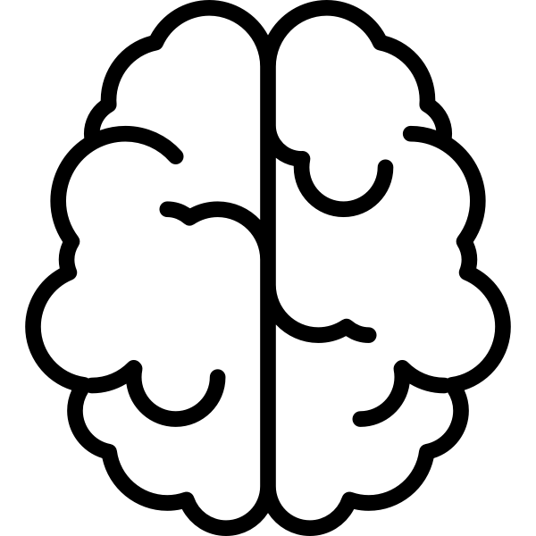

AI Pet Companion System
Value:
Players wanting virtual animal companions
Game developers looking to create engaging and personalized pet systems
Educate player on pet care and responsibility
Technology:
LLM integration for creature generation and traits
Behavior Trees for complex pet decision-making and actions
Heuristic evaluation for mood and needs assessment
Unity for game development and creature animation
Team:
Shanaya Malik, Matthew Streib, Trinity Wu, Luan Ta
Themes:
AI as an Adaptive Companion
AI as a Dynamic Pet
Novelty:
Multi-layered AI combining genetic evolution with learned behaviors
Customizable creatures that develop distinct traits and responses based on player interactions
Dynamic personality adaptation with meaningful consequences if needs are not met
An adaptive AI-driven virtual pet companion system where creatures evolve unique personalities and behaviors based on player interaction and care patterns.
Work Plan:
Shanaya: Algorithm implementation for creature generation & trait inheritance; behavior modeling system design
Trinity: LLM integration for personality generation; implementation of mood & growth tracking
Matthew & Luan: Core game mechanics, shop interface, behavior tree implementation, and resource management systems

